Slide 1
A Beginner’s Guide to NIH
UCSF Liver Center
October 26, 2016

Slide 2
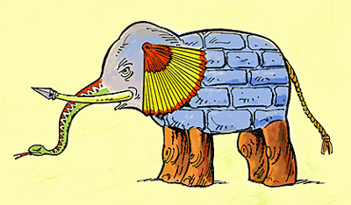
Lessons from Elephants

Slide 3

Understanding Elephants
Sometimes you need a multidisciplinary
team of zoologists
  How do I prepare my strongest submission?
  How should I move forward following my grant’s review?
  Now that my project has been funded, what’s next?
Sometimes you need to consult a pachydermologist
  What opportunities are available to me at NIH?
  What is NIDDK Program looking for in a project?
  What is the current policy at NIDDK?
  Is it different at another NIH Institute? – African vs. Asian specialists.

Slide 4
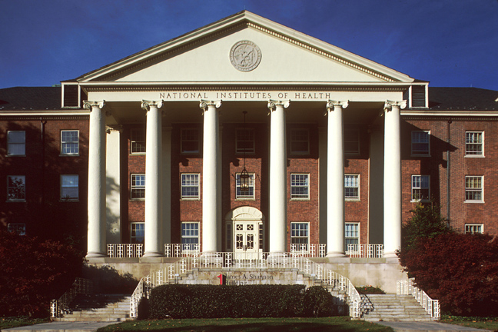
National Institutes of Health
Much of the biomedical research in the United States is supported by the Federal government, primarily the National Institutes of Health (NIH)
One agency of 10 within the U.S. Department of Health and Human Services (HHS)
Comprises 27 Institutes and Centers (IC)

Slide 5
NIH Mission
NIH’s mission is to seek fundamental knowledge about the nature and behavior of living systems and the application of that knowledge to enhance health, lengthen life, and reduce illness and disability.
(NIH supports basic and clinical research)

Slide 6

National Biomedical Research Portfolio
Clinical Research
Clinical
Research
Translational Research
Translational
Research
Basic
Research
Basic Research
NIH - $30B
Private Sector - $59B
Notes:
6
2010 figures
The next few slides are meant to convey perspective on NIH place in the Research Funding and Federal Funding Hierarchy’s

Slide 7

National Institutes of Health
Office of the Director
National Institute
on Aging
National Institute
on Alcohol Abuse
and Alcoholism
National Institute
of Allergy and
Infectious Diseases
National Institute
of Arthritis and
Musculoskeletal
and Skin Diseases
National Cancer
Institute
National Institute
of Child Health
and Human
Development
National Institute on
Deafness and Other
Communication
Disorders
National Institute
of Dental and
Craniofacial
Research
National Institute
of Diabetes and
Digestive and
Kidney Diseases
National Institute
on Drug Abuse
National Institute
of Environmental
Health Sciences
National Eye
Institute
National Institute
of General
Medical Sciences
National Heart,
Lung, and Blood
Institute
National Human
Genome Research
Institute
National Institute
of Mental Health
National Institute
of Neurological
Disorders and
Stroke
National Institute
of Nursing Research
National Institute of
Biomedical Imaging
and Bioengineering
National Center
for Complementary
and Integrative Health
Fogarty
International
Center
National Center
for Advancing
Translational Sciences
National Library
of Medicine
National Center on
Minority Health and
Health Disparities
Clinical Center
Center for
Information
Technology
Center for
Scientific Review

Slide 8
NIDDK Mission
To conduct and support medical research and research training and to disseminate science-based information on diabetes and other endocrine and metabolic diseases; digestive diseases, nutritional disorders, and obesity; and kidney, urologic, and hematologic diseases, to improve people’s health and quality of life

Slide 9
Core NIDDK Goals Principles
Maintain a vigorous Investigator-initiated research portfolio
Support pivotal clinical studies and trials
Preserve a stable pool of talented new investigators
Foster exceptional research training and mentoring opportunities
Ensure knowledge dissemination through outreach and communications

Slide 10
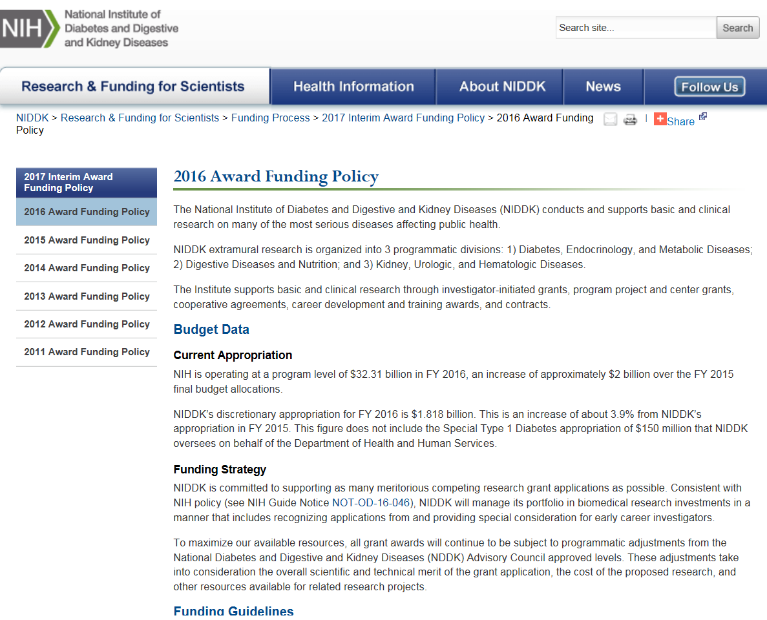
NIDDK’s Award Funding Policy is Published

Slide 11
FY 2016 Budget
NIH | FY 2015 | FY 2016 | Δ | %Δ
Total Prog. | $30.31B* | $32.31B* | $2B | 6.6
NIDDK | FY 2015 | FY 2016 | Δ | %Δ
Total Prog. | $1.899B* | $1.968B* | $69M | 3.6*/4.0
*Includes Special Diabetes Program, $150M

Slide 12
NIDDK FY 2015 Budget by Mechanism
FY15 Budget*
$1,749,140
* Does not include Type 1 Diabetes Special Statutory Authority

Slide 13
How do we set the payline?
Total budget | 100
Centers | 7
Training | 3
Careers | 5
Intramural | 10
Non-competing renewals | 54
Administrative overhead | 4
Miscellaneous | 2
Contracts | 5
Remainder | 10
Initiatives
Payline

Slide 14
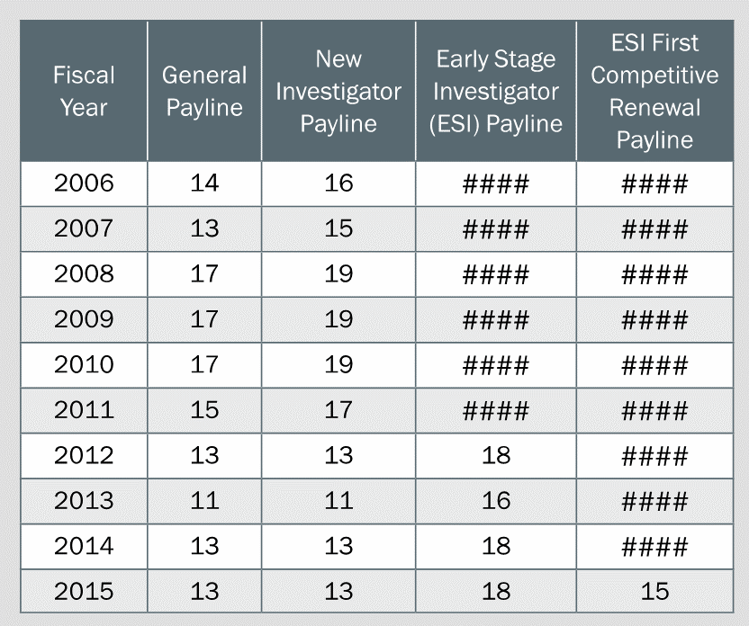
Pressures on the R01 Payline
Trends in award costs
Trends in application numbers
Out-year commitments
  Noncompeting renewals
Notes:
DK got almost 70 million more dollars---why didn’t the payline go up?
Useful to spend a few moments explaining a number of different trends that are affecting our budget:

Slide 15
Trends in Award Cost
Trends in Award Costs
Cost per Grant Has Risen More than Total R01 Budget
19% increase
4% increase
Median total costs of R01 grants
Overall NIDDK Expenditures on R01s

Slide 16
Trends in Application Numbers
Number of competing NIDDK R01 Applications
~2930
26% increase

Slide 17
Can Reduce Pool Available for New Awards
Outyear Commitments
Total number of NIDDK R01/R37 Awards
Notes:
Multi-year commitments like R01s have long, expensive “tails”….

Slide 18

Life Cycle of a Grant
New Directions
Other Mechanisms
Other Agencies/Foundations
Renewal
Application
Receipt and Referral
?
Initiates
Research Idea
Study Section
Submits Application
Institute
Allocates Funds
Advisory Councils & Boards
Research
Budgets
Regulations
Personnel
Institute Director
Institutional,
Professional, and
Personal responsibilities
Available Resources
Notes:
3 times a year

Slide 19
The Bottom Line: Overall Impact
Impact: The likelihood of the research to exert a sustained, powerful influence on the particular research field.
Translation for Reviewers: The first question to ask is “How much do I care that this project is done?” Then, depending on the answer, the next important questions is “Can they do it?”

Slide 20
Specific Aims
Specific aims – the yardstick by which success is measured
How will progress in meeting the Specific Aims be measured?
  Publications, publications, publications
Make sure they match the Approach (read your final application backwards)
Hypotheses should be well articulated and accessible
End with a cogent, compelling impact statement

Slide 21
Critiques: Review Criteria
Aligned with application
  Significance
  Investigator(s)
  Innovation
  Approach
  Environment
Human Subjects Protections and/or Humane Use and Care of Vertebrate Animals
Biohazards as appropriate

Slide 22
Significance
Charge to Reviewers
What they Look For
Is there a strong scientific premise?
Address whether the project advances its field, not whether the field is important.
Does the project address an important problem or barrier to progress in its particular field?
How much will the project improve knowledge, technical ability, or clinical practice?
A compelling premise for your project.
If accomplished as presented, will and how the results have a substantial effect on the field.
Seek out the panel that will appreciate the importance of your work.

Slide 23
Scientific Premise
GOAL: Ensure that the underlying scientific foundation of the project—concepts, previous work, and data (when relevant)—is sound.
Pertains to the underlying evidence/data for the project
As an applicant you should:
  Provide sufficient justification for the proposed work
  Cite appropriate work and/or preliminary data
  Appropriately identified strengths and weaknesses in prior work in the field
  Proposes to fill a significant gap in the field
  OR explained why this is not possible?
  Important not to substitute hypothesis with premise
  - Addition to the review criteria (Significance): “Is there a strong scientific premise?”

Slide 24
Investigator(s)
Charge to Reviewers
What They Will Look For
Evaluate the PD/PI(s)’ ability to lead the project.
Do not limit evaluation to the PD/PI(s), evaluate the collaborative team.
Evaluate Multiple PD/PI leadership plan if applicable.
Overall productivity in the context of career stage.
If a competing renewal, progress during the previous cycle.
If a new application, productivity associated with any previous funding.
Training and demonstrated expertise of the PI(s)
Commitment of the team.
The combined expertise of the team. Is the required skill set covered?

Slide 25
Investigator(s)
The PI(s) don’t need to have all of the expertise required for a project, they need to have the expertise to lead the project team.
Recruit co-Investigators, etc. with recognized expertise.
Biosketches: Personal statements should relate to your project and their role in it.
Letters of Support: Should be related to your project and match your stated approach.
Essential personnel should have a committed effort.

Slide 26
Innovation
Charge to Reviewers
What They Look For
Are the theoretical concepts, approaches, methodologies, instrumentation or interventions novel?
How broadly applicable is the innovation? Is it confined to this field or broader?
Vertical versus horizontal science.
Innovation can be conceptual and/or methodological.
Note: Not all impactful projects are highly innovative.

Slide 27
Approach
Charge to Reviewers
What They Look For
Are there “strategies to ensure a robust and unbiased approach, as appropriate for the work proposed?”
Is the research strategy well-reasoned and supported? Does it employ appropriate methods and analyses?
Will the Aims address the hypothesis?
Are expected results, alternative results, and potential pitfalls addressed?
Do the what and why make sense?
Can the work be accomplished in the project period with the resources?
Do the Aims/Subaims directly address the hypothesis/sub-hypothesis? Will they yield convincing data?
Is/are the PI(s) considering limitations, important experimental variables, or the possibility of alternative results in the research approach?

Slide 28
Approach
Communicate well. Don’t assume what they know.
Provide sufficient premise – pilot data (take a critical approach to how you interpret it) and/or support from the literature (don’t neglect contradictory papers)
Realistic timelines – Avoid being overly ambitious.
Address the hypothesis directly. Focused and deep.
Address limitations and the possibility of unanticipated results head on.
Get input from collaborators.

Slide 29
Scientific Rigor
GOAL: Ensure a strict application of scientific method that supports robust and unbiased design, analysis, interpretation, and reporting of results, and sufficient information for the study to be assessed and reproduced. Give careful consideration to the methods and issues that matter in your field.
Pertains to the proposed research
Address under Approach
Possible considerations, if appropriate for the scientific field and research question, include plans for:
  determining group sizes
  analyzing anticipated results
  reducing bias
  ensuring independent and blinded measurements
  improving precision and reducing variability
  including or excluding research subjects
  managing missing data
  Addition to review criteria (Approach): Are there “strategies to ensure a robust and unbiased approach, as appropriate for the work proposed?”

Slide 30
Sex As a Biological Variable
Consideration of sex, included under the umbrella of “Relevant Biological Variables”, is required in all studies involving human subjects or vertebrate animals.
NIH expectations:
As part of the Consideration of Relevant Biological Variables, applicants must provide adequate plans to address sex as a biological variable (for studies involving vertebrate animals or human subjects).
If the study involves only one sex, is this justified scientifically?
  Reviewers will assess within the context of the research question and current scientific knowledge (Approach).

Slide 31
Environment
Charge to Reviewers
What they Look For
Assess the appropriateness of the resources, facilities and needs, and equipment for the particular project.
Could also incorporate intellectual resources in the environment.
Are experts with intellectual and technical expertise readily available?
Are the resources available?
Institutional commitment to New PIs and ESIs.
This includes Core facilities

Slide 32
Competitive Renewal Applications
Competitive renewal (type 2) application is based on the “outflow” from the type 1 grant
Were the aims completed? Is this documented (publications)? Is the research community familiar with the work? Is the work still interesting to the research field? Is it important? Does it contribute to a broad understanding of the field?

Slide 33
Additional Review Considerations
Applications from Foreign Organizations
Select Agent Research
Resource Sharing Plans
Budget and Period of Support
  Appropriateness of requested budget: personnel and supplies
  Potential overlap with other projects
Additional Comments to Applicant
  Explicit reviewer guidance to applicants (optional)

Slide 34
Resource Authentication Attachment
GOAL: Ensure processes are in place to identify and regularly validate key resources used in their research and avoid unreliable research as a result of misidentified or contaminated resources.
Researchers are expected to authenticate key biological and/or chemical resources used in their research, to ensure that the resources are genuine.
New Additional Review Consideration
  Authentication of Key Biological and/or Chemical Resources: For projects involving key biological and/or chemical resources, reviewers will comment on the brief plans proposed for identifying and ensuring the validity of those resources.

Slide 35
Impact/Priority Score
The result of all panel members.
If assigned reviewers disagree, the Impact/Priority score will indicate which argument held the most sway. This should be reflected in the Resume and Summary of Discussion
No single reviewer is responsible for the outcome. It is a group decision.

Slide 36
Percentile
Indicates the project’s ranking within the group.
More informative than raw Priority/Impact Scores.
For standing Study Sections, the percentile base consists of R01s reviewed by that panel (current round plus the previous two).
  A score of 30 might rank 10th percentile in Study Section A and 20th percentile in Study Section B.
For Special Emphasis Panels (SEPs), the base consists of three rounds of all R01s reviewed at CSR.
Not all applications are percentiled (Ex: PARs, RFAs, R21s).

Slide 37
Resume and Summary of Discussion
Prepared by SRO after the meeting
  Critiques, on the other hand, may or may not be edited after the discussion.
Elements:
  Brief synopsis of proposed project
  Impact and significance (from the panel’s perspective)
  Most important (“score driving”) strengths and weaknesses
  Additional issues raised during the discussion that are not described in critiques
  Differences in opinion and if/how they were resolved
  Conclusion

Slide 38
Critiques: Criterion Scores
Do not over-interpret
Provided before the meeting
Criterion scores do NOT:
  Average out to be the overall score
  Always reflect the final score
  Undergo discussion at the meeting
Criterion scores might:
  Provide a guide for which criteria were stronger and which were weaker

Slide 39
Contact your Program Officer
POs may be able to provide guidance on:
The likelihood of NIH funding the application
Further discussion of the reviewers’ comments (if the PO was present at the review)
Whether to submit a new or resubmission application
What to address in your next submission
The acceptable bases for appealing the peer review process

Slide 40
To Resubmit or Not?
In most cases, it is advantageous to revise and resubmit your application and request assignment to the same study section
Was the application reviewed in the right study section?
Did the reviewers' expertise fit your topic?
Were they knowledgeable about your methods?
Did they understand the rationale for your research?

Slide 41
Acknowledge Your Center’s Contribution in Presentations & on Posters
If the DDRCC was used for the studies, acknowledge the Center by grant number
(ex: P30DK000000)
Consider briefly mentioning what services you used
If funded through a P& F award, list it

Slide 42
Rigor and Transparency
NIH Notice NOT-OD-16-011 discusses how both application instructions and review language have been updated for most research grant applications.
NOT-OD-16-181 addresses the new FORMS-D application forms and instructions.
NOT-OD-16-012 provides guidance for Career Development Awards.
NOT-OD-16-034 provides guidance for Institutional Training Grants, Institutional Career Development Awards, and Individual Fellowships.
NOT-OD-16-031 provides guidance for RPRRs (progress reports).
NIH’s Office of Extramural Research has established a website to assist PIs with this requirement.

Slide 43
Useful information: Be in the know!
NIDDK Webpage
NIH Guide https://grants.nih.gov/funding/about-nih-guide-to-grants-and-contracts.htm
NIH Office of Extramural Research http://grants.nih.gov/grants/oer.htm
Notes:
Know this page!!
Sign up for NIH Guide for Grants and Contracts Listserves
Know about different grant mechanisms-not all ICs sign up for all types
Dr. Sally Rockey blog: she is NIH’s Deputy Director for Extramural Research

